Slide 1
3D Game engine Programming
Neil Gannon

Slide 2
Overview
An Introduction to some common elements we will encounter and elaborate on during the semester
Vectors
Matrices
Geometric Elements
Transformations
Rotations
Each will be expanded upon in future classes
Either via theory or practical work

Slide 3
Coordinate Systems

Slide 4
Coordinate System
There are a lot of different coordinate systems in existence
What is a coordinate?
A set of variables that allow us to position a geometric object
Typically the number of variables is equal to the number of dimensions in the coordinate system
3D game will have a coordinate made of three variables
Games in particular frequently some of these:
Cartesian coordinates
Cylindrical coordinates
Spherical coordinates
We are directly interested in Cartesian Coordinates

Slide 5
Cartesian Coordinate System
Rectilinear coordinate system
Rectangular in nature
Each axis of the space is perpendicular to the other axis
Each axis is 90 from one another
MonoGame uses a right hand coordinate system
Positive Z is towards the screen
In a left handed the positive is away
Previously you have worked with 2 components vectors
Y
World Origin
X

Slide 6
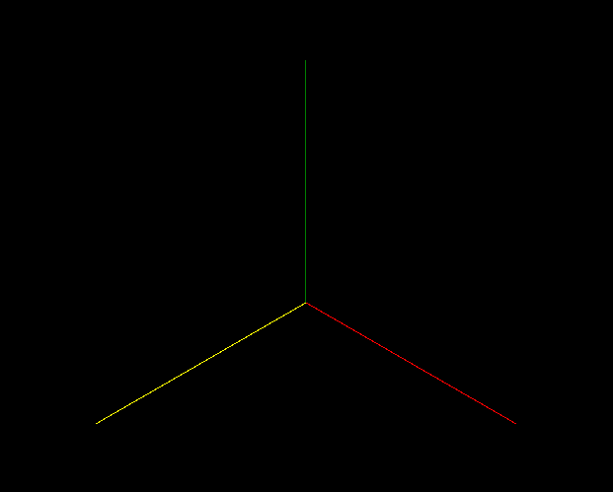
Cartesian Coordinate System
Previously you have worked with 2 components vectors
We will have 3 Axis to work with
X, Y, Z (Horizontal, Vertical, Depth)
Previous 2D subject was X, Y (Horizontal, Vertical)
Right handed coordinate system
Positive Z axis is coming towards the viewer
Some game engines swap the Axis
Unreal Engine Y and Z Axis are swapped
+Y
0,0,0
+Z
+X

Slide 7
Vectors

Slide 8
Vectors
You already have a good understanding of using vectors
Previously you would have used Vector2(X, Y) to place object in *two dimensional space
In this module we will be using Vector3(X, Y, Z) to do the same thing
What is a vector?
A vector is the math equivalent to an array
A vector isn’t exactly a coordinate
It also has a direction (Angle) and a magnitude (Length)
We could say a single coordinate is a vector from the origin (0, 0)
Or a vector is a coordinate offset from the origin (0, 0)

Slide 9
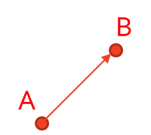
Vectors
A vector is defined by n-coordinates
Each component of the vector is typically assigned to an axis
Most games will use vectors with 2 or 3 components
Vector2 and Vector3
Typically a vector is defined as two or more coordinates in a space
With two points we say the vector has a head and a tail
Starts at the tail, ends at the head
Vectors have their own relative space
Known as vector space

Slide 10
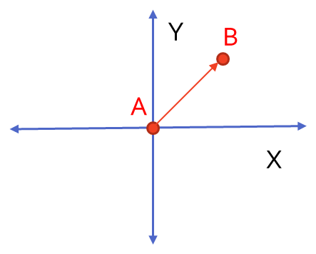
Vectors
Think of a vector as an arrow
Arrow indicates the direction
Starts at the tail and points towards the head
The head is the actual (X, Y, Z) component
The head can be placed anywhere in coordinate space
The only restriction is that it is a given distance from the tail
If our vector is (1, 2, 3)
It is separated form the tail by a distance of (X=1, Y=2, Z=3)
On the right the tail is at the origin
The head is given distance from the origin
To calculate the value of the vector AB = (B - A)

Slide 11
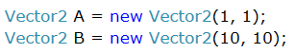
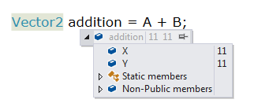
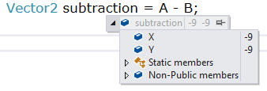
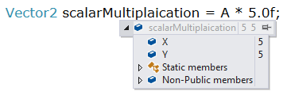
Vector Operations
Addition
Simple addition of two or more existing Vectors
Subtraction
Simple subtraction of two or more existing vectors
Scalar Multiplication
Multiply a Vector by a Scalar
Scaling the size of an entire Vector by a floating point value
Not multiplying by another vector

Slide 12
Vector Operations
Cross Product
The cross product of two 3D vectors (A, B) will result in a new vector
The new vector is perpendicular to the vectors A and B
Dot Product
Angle between two Vectors
Produces a Scalar often known as the Scalar Product
Normalization
Creates a Unit Vector from a given vector
Converts your vector into a Vector of length between 0 and 1, angle will scaled to be the same
Transformations
Transforms a Vector by a given Matrix

Slide 13
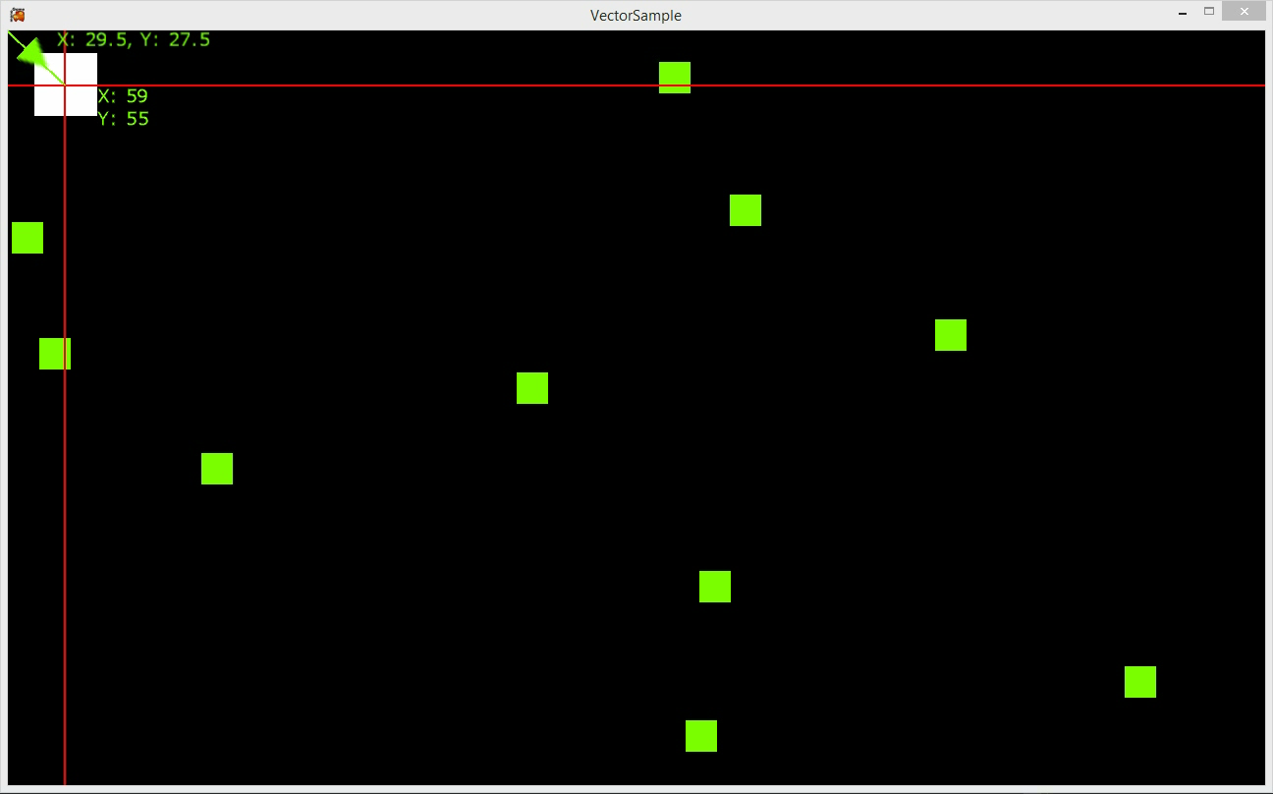
Vector2 Sample Application

Slide 14
Matrices

Slide 15
Matrix
A Matrix is 2D grid of numbers
Can have as many rows and columns as are needed
Each element can store any numerical value
We can perform many arithmetic operations with a matrix
Addition
Subtraction
Multiplication
The matrix is one of the key data structures you will be using
Simplify representation and computation
Great at transformations
MonoGame matrix has a lot of built in functions (4x4 Matrix)

Slide 16
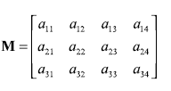
Matrices Visualised
Representation
A matrix will have a number of rows and columns
A 3X4 Matrix will have 3 rows and 4 columns
3 Rows
Each row will have 4 columns

Slide 17
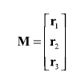
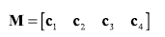
Matrices
Representation
We can also view matrices in a more compact form
Or atomic elements
Just the rows
A column matrix
Just the columns
A row matrix
When working with MonoGame we wont be viewing matrices like this but this notation is common in development research and will come in handy

Slide 18
Matrices and Games Development
What does matrix mean for us?
Transformations
We will use the matrix to store the current transforms of our 3D objects
Translation
Rotations on each Axis (X, Y, Z)
Scale
When you produce a model in a modelling tool
The coordinate space origin is the centre of the model
We can use a matrix to transform the model from it’s local space to our game spaces
Will cover some issues that can arise when exporting later

Slide 19
Matrices
There are three core matrices that form the backbone of a most 3D games
World (Each objects transformation in world space)
View
Projection
These matrices will allows use to transform our objects to be drawn on screen
Every 3D object to be drawn will need these
These will feature in a range of functions throughout the engine
And can serve many purposes (View Culling, Spatial Partitioning, etc.)
Camera Related

